Slide 1
File upload in PHP
File upload in PHP allows you to upload files with different extensions to the server.
We can use HTML forms and enable the users to upload files to the server.
These files are stored in a temporary directory unless moved to a target location for permanent storage. But for the file upload in PHP to work, we have to ensure some configuration settings are set appropriately.
In your "php.ini" file, search for the file_uploads directive, and set it to On:
file_uploads = On

Slide 2
How to Configure PHP Settings to Ensure Smooth File Upload in PHP?
If you are aware of the php.ini file location, it’s well and good. But if you don’t know the exact location, use the below code to locate it.
<? php echo php_ini_loaded_file(); ?>
php_ini_loaded_file() is a built-in function. Create a PHP file with this code and open it from your browser through a local server to get the location of the php.ini file.
Once you have the location, you need to find and configure some settings.

Slide 3
The primary settings along with recommended values are:
Allows file uploads
file_uploads = On
Temporary directory where upload files are temporarily stores
upload_tmp_dir =
Max file size approval
: upload_max_filesize = 16M
Max files upload allowed per request
: max_file_uploads = 20
POST data max size accepted by PHP
: post_max_size = 20M
max_input_time = 60
memory_limit = 128M
max_execution_time = 30

Slide 4
$_FILES
$_FILES is a super global variable which can be used to upload files. Here we will see an example in which our php script checks if the form to upload the file is being submitted and generates a message if true.

Slide 5
$_FILES superglobal in PHP
The $_FILES superglobal in PHP is used to handle file uploads through an HTML form
You need an HTML form to allow users to choose and upload files.
The form should use the POST method with enctype="multipart/form-data" to properly handle file uploads.

Slide 6
enctype="multipart/form-data
The enctype attribute specifies how the form-data should be encoded when submitting it to the server.
Note: The enctype attribute can be used only if method="post".
use multipart/form-data when your form includes any <input type="file"> elements

Slide 7
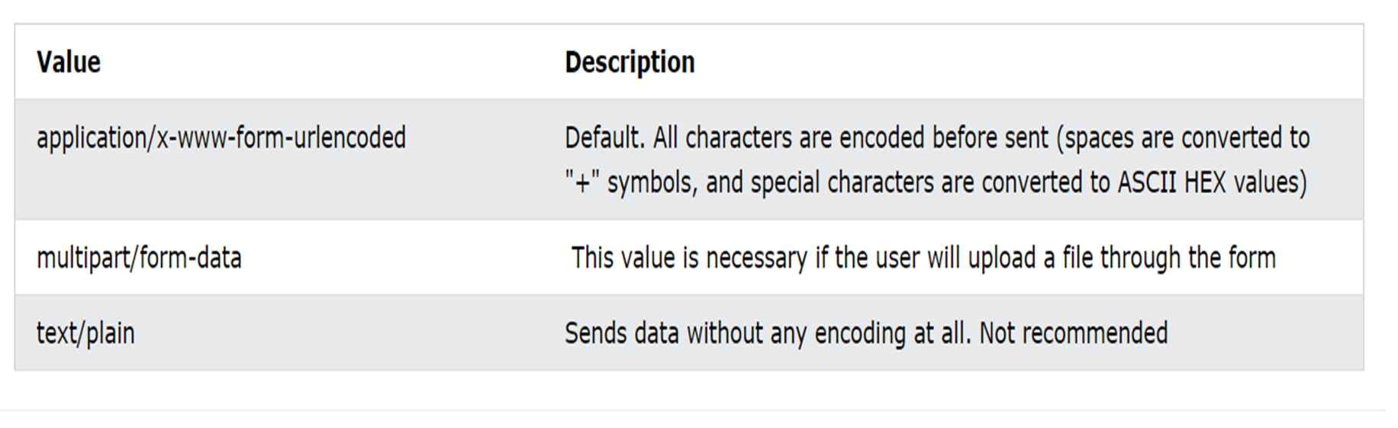
enctype="multipart/form-data"

Slide 8
$files[] in PHP
In PHP, $files[] typically refers to an array that holds multiple file data, such as those uploaded via an HTML form using the $_FILES superglobal. The $_FILES array contains information about uploaded files and allows you to manage them effectively

Slide 9
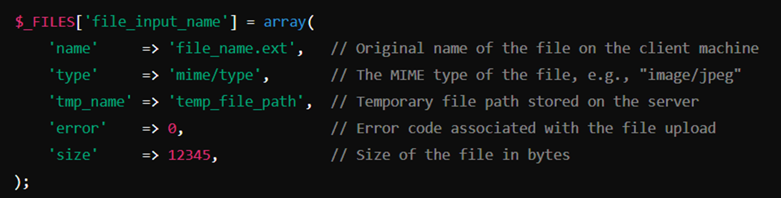
Structure of $_FILES
When a file is uploaded using an HTML form with enctype="multipart/form-data", PHP populates the $_FILES array. The structure looks like this for a single file:

Slide 10


Slide 11
'tmp_name'
In PHP, 'tmp_name' is a key within the $_FILES superglobal array, which refers to the temporary file path where the uploaded file is stored on the server during the file upload process.
When a user uploads a file via an HTML form, PHP stores the file in a temporary directory on the server. The 'tmp_name' value contains the path to that temporary file.

Slide 12
$fileName = $_FILES["fileUpload"]["name"];
$fileName = $_FILES["fileUpload"]["name"];
Description: This retrieves the original name of the file that the user uploaded from their computer.
Example: If the user uploads a file named document.pdf, then $fileName will contain the value "document.pdf".
Use Case: You can use this to show the original file name to the user or store it in a database for reference.

Slide 13
$fileTmpName = $_FILES["fileUpload"]["tmp_name"];
Description: This gets the temporary file name and path that the server uses to store the uploaded file before you move it to a permanent location.
Example: The value might look something like "/tmp/phpYzdqkD", which is a temporary path where the file is stored.
Use Case: You will typically use this with move_uploaded_file() to move

Slide 14
$fileSize = $_FILES["fileUpload"]["size"];
Description: This gives the size of the uploaded file in bytes.
Example: If a file is 2MB, then $fileSize might have the value 2097152 (because 2MB = 2 * 1024 * 1024 bytes).
Use Case: You can use this to check if the uploaded file exceeds a certain size limit and reject it if it's too large

Slide 15
$fileType = $_FILES["fileUpload"]["type"];
Description: This retrieves the MIME type of the uploaded file, which describes the type of file.
Example: Common MIME types are:"image/jpeg" for JPEG images"application/pdf" for PDF files"text/plain" for text files
Use Case: You can use this to ensure that only certain types of files (e.g., images or PDFs) are allowed for upload. This helps with security and maintaining file-type consistency.

Slide 16
$fileError = $_FILES["fileUpload"]["error"];
This checks for any errors that may have occurred during the file upload.
Use Case: This is useful for checking if the file was successfully uploaded or if an error occurred during the process.

Slide 17
PHP uses specific error codes to indicate what went wrong (if anything)
Example of Error Codes:
0 (UPLOAD_ERR_OK): No error, the upload was successful.
1 (UPLOAD_ERR_INI_SIZE): The uploaded file exceeds the upload_max_filesize directive in php.ini.
2 (UPLOAD_ERR_FORM_SIZE): The uploaded file exceeds the MAX_FILE_SIZE directive that was specified in the HTML form.
3 (UPLOAD_ERR_PARTIAL): The file was only partially uploaded.
4 (UPLOAD_ERR_NO_FILE): No file was uploaded.

Slide 18
mkdir()
The PHP function mkdir() is used to create directories in the filesystem.
<?php mkdir("test"); ?>

Slide 19
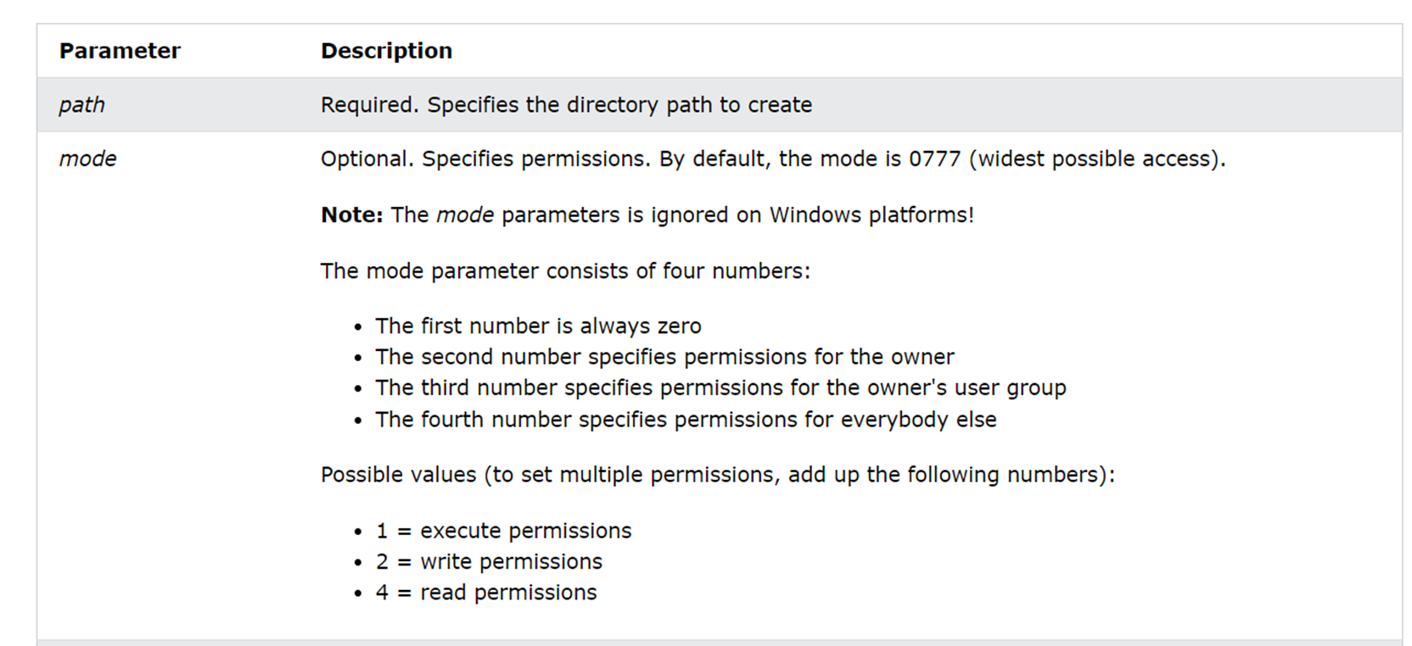
The mkdir() function creates a directory specified by a pathname.

Slide 20
Permission Breakdown
7 (Owner): Read (r), Write (w), Execute (x) — Full permissions.
5 (Group): Read (r), Execute (x), but no write permission.
5 (Others): Read (r), Execute (x), but no write permission.
In summary, 0755 makes the directory accessible for reading and executing by everyone, but only the owner can write (modify) the files inside it.

Slide 21
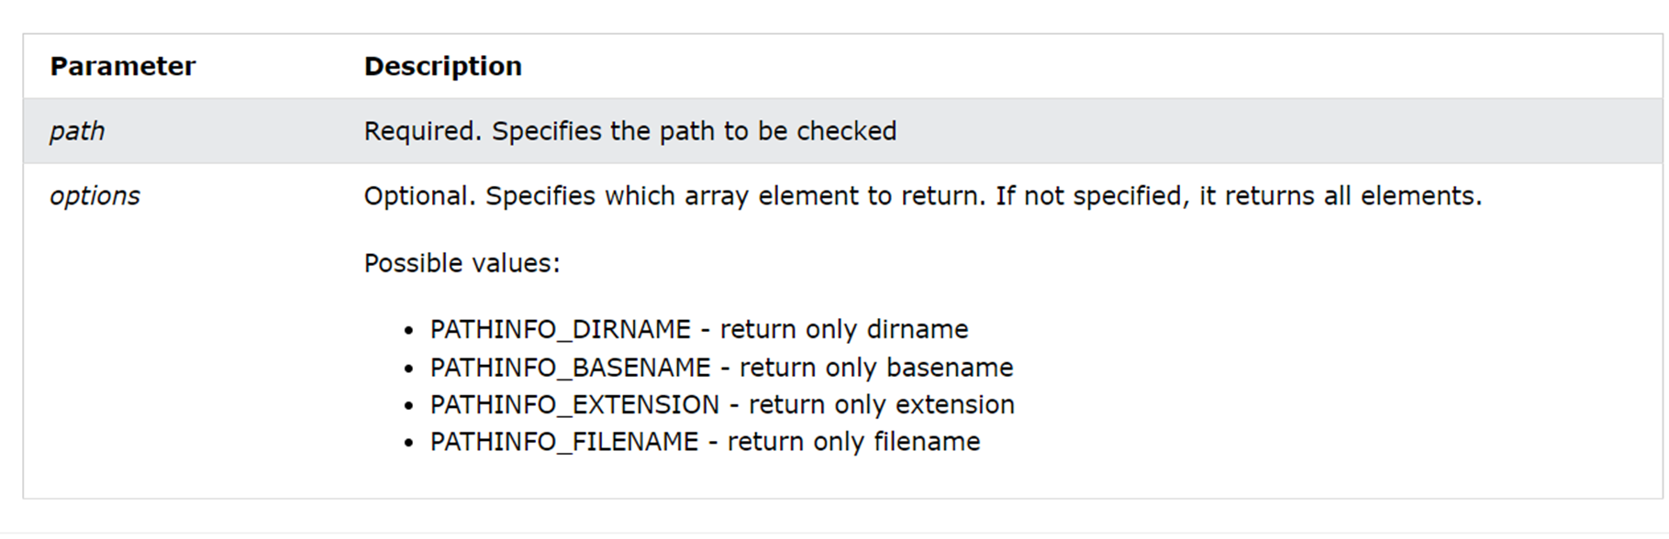
pathinfo(path, options)
The pathinfo() function returns information about a file path.

Slide 22
Creating the HTML Form for File Upload in PHP
<?php
session_start();
?>
<!DOCTYPE html>
<html>
<head>
<title>PHP File Upload</title>
</head>
<body>
<?php
if (isset($_SESSION['message']) && $_SESSION['message'])
{
printf('<b>%s</b>', $_SESSION['message']);
unset($_SESSION['message']);
}
?>
<form method="POST" action="fileUpload.php" enctype="multipart/form-data">
<div>
<span>Upload a File:</span>
<input type="file" name="uploadedFile" />
</div>
<input type="submit" name="uploadBtn" value="Upload the File" />
</form>
</body>
</html>

Slide 23
Creating the Upload Logic for File Upload in PHP
<?php
session_start();
$message = '';
if (isset($_POST['uploadBtn']) && $_POST['uploadBtn'] == 'Upload the File')
{
if (isset($_FILES['uploadedFile']) && $_FILES['uploadedFile']['error'] === UPLOAD_ERR_OK)
{
// uploaded file details
$fileTmpPath = $_FILES['uploadedFile']['tmp_name'];
$fileName = $_FILES['uploadedFile']['name'];
$fileSize = $_FILES['uploadedFile']['size'];
$fileType = $_FILES['uploadedFile']['type'];
$fileNameCmps = explode(".", $fileName);
$fileExtension = strtolower(end($fileNameCmps));
// removing extra spaces
$newFileName = md5(time() . $fileName) . '.' . $fileExtension;
// file extensions allowed
$allowedfileExtensions = array('jpg', 'gif', 'png', 'zip', 'txt', 'xls', 'doc');
if (in_array($fileExtension, $allowedfileExtensions))
{
// directory where file will be moved

Slide 24
$uploadFileDir = 'C:\xampp\htdocs\test';
$dest_path = $uploadFileDir . $newFileName;
if(move_uploaded_file($fileTmpPath, $dest_path))
{
$message = 'File uploaded successfully.';
}
else
{
$message = 'An error occurred while uploading the file to the destination directory. Ensure that the web server has access to write in the path directory.';
}
}
else
{
$message = 'Upload failed as the file type is not acceptable. The allowed file types are:' .implode(',', $allowedfileExtensions);
}
}
else
{
$message = 'Error occurred while uploading the file.<br>';
$message .= 'Error:' . $_FILES['uploadedFile']['error'];
}
}
$_SESSION['message'] = $message;
header("Location: index.php");

Slide 25
Resolving the Common Errors That May Be Encountered While a File Upload in PHP
Some standard errors are:
1. The File Is Too Large-UPLOAD_ERR_INI_SIZE or UPLOAD_ERR_FROM_SIZE errors
2. Temporary Folder is Missing--UPLOAD_ERR_NO_TMP_DIR error
UPLOAD_ERR__NO_FILE error
3. Partial Upload--UPLOAD_ERR_PARTIAL error
4. Can’t Write to Disk--UPLOAD_ERR_CANT_WRITE error

Slide 26
5. A PHP Extension Stopped the File Upload
UPLOAD_ERR_EXTENSION

Slide 27
Creating an html form
Next, create an HTML form that allow users to c
<!DOCTYPE html> <html> <body> <form action="upload.php" method="post" enctype="multipart/form-data"> Select image to upload: <input type="file" name="fileToUpload" id="fileToUpload"> <input type="submit" value="Upload Image" name="submit"> </form> </body> </html>

Slide 28
Upload.php
<?php $target_dir = "uploads/"; $target_file = $target_dir . basename($_FILES["fileToUpload"]["name"]); $uploadOk = 1; $imageFileType = strtolower(pathinfo($target_file,PATHINFO_EXTENSION)); if(isset($_POST["submit"])) { $check = getimagesize($_FILES["fileToUpload"]["tmp_name"]); if($check !== false) { echo "File is an image - " . $check["mime"] . "."; $uploadOk = 1; } else { echo "File is not an image."; $uploadOk = 0; } } ?>

Slide 29
You will need to create a new directory called "uploads" in the directory where "upload.php" file resides. The uploaded files will be saved there.

Slide 30
Check if File Already Exist
if (file_exists($target_file)) { echo "Sorry, file already exists."; $uploadOk = 0; }

Slide 31
Limit File Size
we want to check the size of the file. If the file is larger than 500KB, an error message is displayed, and $uploadOk is set to 0:

Slide 32
if ($_FILES["fileToUpload"]["size"] > 500000) { echo "Sorry, your file is too large."; $uploadOk = 0; }

Slide 33
Limit File Type
if($imageFileType != "jpg" && $imageFileType != "png" && $imageFileType != "jpeg" && $imageFileType != "gif" ) { echo "Sorry, only JPG, JPEG, PNG & GIF files are allowed."; $uploadOk = 0; }

Slide 34
Now complete it
^{<?php} ^{$target_dir = "uploads/";} $target_file = $target_dir . basename($_FILES["fileToUpload"]["name"]); ^{$uploadOk = 1;} $imageFileType = strtolower(pathinfo($target_file,PATHINFO_EXTENSION)); ^{if(isset($_POST["submit"])) {} $check = getimagesize($_FILES["fileToUpload"]["tmp_name"]); ^{if($check !== false) {} echo "File is an image - " . $check["mime"] . "."; ^{$uploadOk = 1;} ^{} else {} ^{echo "File is not an image.";} ^{$uploadOk = 0;} } }

Slide 35
if (file_exists($target_file)) { echo "Sorry, file already exists."; $uploadOk = 0; } if ($_FILES["fileToUpload"]["size"] > 500000) { echo "Sorry, your file is too large."; $uploadOk = 0; } if($imageFileType != "jpg" && $imageFileType != "png" && $imageFileType != "jpeg" && $imageFileType != "gif" ) { echo "Sorry, only JPG, JPEG, PNG & GIF files are allowed."; $uploadOk = 0; }

Slide 36
// Check if $uploadOk is set to 0 by an error if ($uploadOk == 0) { echo "Sorry, your file was not uploaded."; // if everything is ok, try to upload file } else { if (move_uploaded_file($_FILES["fileToUpload"]["tmp_name"], $target_file)) { echo "The file ". htmlspecialchars( basename( $_FILES["fileToUpload"]["name"])). " has been uploaded."; } else { echo "Sorry, there was an error uploading your file."; } } ?>

Slide 37
Php sending E-mails()
The mail() function allows you to send emails directly from a script.

Slide 38
syntax
mail(to,subject,message,headers,parameters);
To: Required. Specifies the receiver / receivers of the email
Subject: Specifies the subject of the email.
Message: Defines the message to be sent. Each line should be separated with a LF (\n). Lines should not exceed 70 characters.

Slide 39
Headers: Optional. Specifies additional headers, like From, Cc, and Bcc. The additional headers should be separated with a CRLF (\r\n).
Parameters: Optional. Specifies an additional parameter to the sendmail program (the one defined in the sendmail_path configuration setting).

Slide 40
<?php $msg = "First line of text\nSecond line of text"; $msg = wordwrap($msg,70); mail("someone@example.com","My subject",$msg); ?>

Slide 41
The mail() function allows you to send email directly from a script.
https://github.com/mailhog/MailHog/releases
Accessing the mailhog
http://localhost:8025

Slide 42
Configure PHP to use MailHog:
Open PHP.ini
Search mail function and replace
Localhost:25 with Localhost:1025

Slide 43
<?php
$to=‘abc.123@gmail.com’;
$subject=‘test Email’;
$message=‘this is a test email using MailHog on Windows’;
$headers=‘From: webmaster@example.com.’”\r\n”;
‘Reply –To: webmaster@example.com’.”\r\n.
‘X-Mailer:PHP/’.phpversion();
If (mail($to,$subject,$message,$headers))
{
echo ‘Email sent successfully!’;
}
Else
{
echo ‘Failed to send email.’;
}
?>

Slide 44
Task
Create a simple image gallery system in PHP where users can upload images.
a).Once uploaded, the images should be stored on the server and displayed in a grid format on the webpage.
b).Ensure that only images of type JPEG, PNG, and GIF are accepted, and enforce a maximum file size of 3MB.

